Slide 1
PROLOTHERAPY
AN IMPORTANT TOOL FOR MSK PAIN MANAGEMENT
MAYO FRIEDLIS,MD
Stem Cell Arts/National Spine and Pain
Washington DC
LAOM, BA 0913

Slide 2
My background
25 years Prolotherapy
8 years PRP
4 years Stem cells
Interventional Pain on the side

Slide 3
PROLOTHERAPY
YOU NEED TO LEARN THIS
TECHNIQUE
(Why would you? )

Slide 4
OBJECTIVES
Why you need to know this
Definition
Understanding how prolotherapy works
Studies in the literature
Indications/Usage
Injection Techniques

Slide 5
WHY PROLOTHERAPY?
Also a Regenerative Injection Technique RIT
RIT in its most basic form
Prolo is a concept of understanding MSK tissue injury and repair
Prolo is a methodology of treatment application
to ensure the injury is completely treated
More and more RCT’s being published (this really works!)

Slide 6
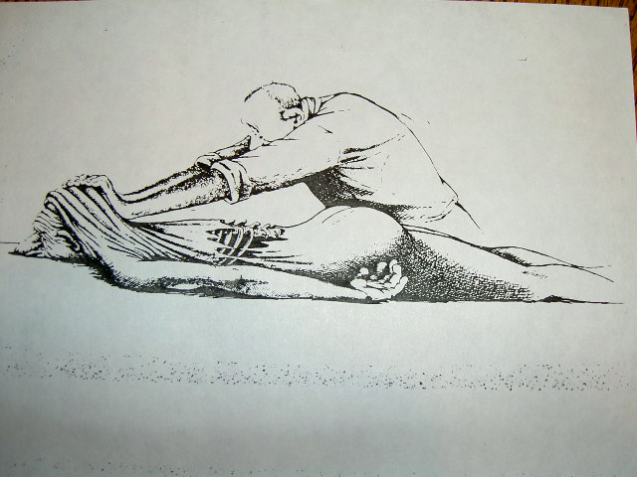

Slide 7
Where did Prolotherapy come from?
Lessons from history
George Hacket and others discover that most MSK pain comes from ligaments and joint capsules- 1935
He perfects the treatment process called Prolotherapy capable of resolving these injuries
Exactly at this time Mixter and Barr discover that you can operate on the lumbar disc.
We enter the age of spine surgery and the dark ages of medicine. Much wisdom and knowledge is lost

Slide 8
HISTORY OF PROLO -cont
1980 Prolotherapy is “rediscovered” by physicians who founded the AAOM to teach and promote to other physicians

Slide 9
PROLO AS A THOUGHT PROCESS
The nature of MSK injury
Not muscular
Not joint
Not nerve (it’s ligament)
Treating the entire joint/area/organism
Eg: A shoulder problem is never just the SS tear
Why did that tear occur? What must be done to completely treat the shoulder?
Need to address the ligament laxity and muscular imbalance

Slide 10
PROLO AS A METHODOLOGY
Teaches you how to treat the entre area, not just the lesion on MRI or US. This makes cure more likely
Has an 80% success rate which tends toward curative (all or none response)

Slide 11
ADVANTAGES OF PROLO
Simple to perform once learned
No equipment or preparation
Treats larger areas-cervical thoracic lumbar spines
As a method of treatment, it addresses the entire organ, insuring stability of the long term
More affordable for many injuries
Same outcomes as PRP (tears excepted)
5-10% of patients respond to Prolo but not PRP

Slide 12
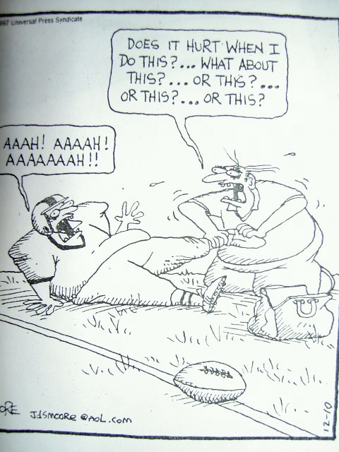

Slide 13
DEFINITION
PROLO – To proliferate
The injection of a substance to stimulate the growth of connective tissue thereby strengthening weakened and painful ligaments, tendons, and joint capsules
Prolotherapy also known as:
“Sclerotherapy”
“Ligament Reconstructive Therapy”

Slide 14
PROLIFERANT SOLUTIONS
Osmotics
12.5% - 25.0% Dextrose
Glycerine 25%
Zinc Sulfate

Slide 15
PROLIFERANT SOLUTIONS, Continued
Chemical Irritants
Phenol 2.5%
Tannic Acid
Quinine
Guaiacol
Calcium Gluconate

Slide 16
HISTORY OF PROLOTHERAPY
Hippocrates
1500 A.D. – French surgeon Paret
1927 - First histologic report on animals
1939 - Hackett
Current usage over 50 years

Slide 17
HOW PROLOTHERAPY WORKS
Normal healing of wounds occurs in three phases
Inflammation phase
Proliferative phase
Remodeling phase

Slide 18
Wound Healing
COMPLETE
HEALING
TISSUE REMODELING
TISSUE REGENERATION
INFLAMMATION
(Cell Proliferation)
NATURAL HEALING CASCADE
INJURY

Slide 19
WOUND HEALING
Inflammatory Phase
Injury to cells (the wound)
Cells broken open, spilling contents
Debris and chemicals released: kinins, complement cascade, fibrinolysis, prostaglandins, pain
Cause of influx of leukocytes
Lasts one to three days

Slide 20
WOUND HEALING, Continued
Proliferative Phase
Hormones released which attract macrophages, granulation cells, fibroblasts in succession
Macrophages clean up debris
New blood vessel growth stimulated
Fibroblasts stimulated to make new ligaments by hormones released by macrophages
Can only happen with a fresh injury state
Lasts ten days to two weeks

Slide 21
WOUND HEALING, Continued
Remodeling Phase
Collagen fibrils form along stress lines
Water squeezed out of fibrils
Collagen cross-linked
Occurs for two to three months

Slide 22
WOUND HEALING SUMMARY
Prolotherapy is a way to jump-start the normal repair process.
Lesson : Reconsider the use of anti-inflammatories given for acute injuries.

Slide 23
CONNECTIVE TISSUE RESEARCH
Hackett, 1956
Showed 40% increase in diameter and size of fibril osseous junction of rabbit tendons two months after injection with proliferant solution
Similar studies in medial collateral ligaments

Slide 24
CONNECTIVE TISSUE RESEARCH, Continued
Liu, 1983
Studied rabbit medial collateral ligament
Injected proliferant one time in test cases
Control injected with NaCl
Findings : 42 days later – proliferant-injected ligament showed significant increase in mass, thickness, and strength

Slide 25
CONNECTIVE TISSUE RESEARCH, Continued
Maynard, 1985
Studied patellar tendons and Achilles tendons
Showed increased diameter and cell numbers

Slide 26
CONNECTIVE TISSUE RESEARCH, Continued
Klein, 1989
Human SI ligaments
Showed proliferant-treated ligaments hypertrophied (ligament hypertrophy NOT scar tissue)
Increased ligament diameter by 60%

Slide 27
CLINICAL STUDIES
Hackett, 1960 monograph
1,816 patients
Followed for 20 years
82% satisfactorily cured
No complications

Slide 28
CLINICAL STUDIES, Continued
Ongley, 1987 – Lancet
81 patients
Low back pain greater than one year
Experimental group – six weekly injections of P2G proliferant
Control group – six weekly injections
of NaCl
RESULTS: Significant improvement in disability scores and pain ratings

Slide 29
CLINICAL STUDIES, Continued
Klein, 1993
General spinal disorders
Randomized double-blind study
79 patients
Experimental group – six weekly injections of P2G plus lidocaine
Control group – six weekly injections of NaCL plus lidocaine
RESULTS: 30/39 of experimental group had greater than 50% reduction in pain; only 21/40 of control group showed similar response
Problem with study – the control was also therapeutic

Slide 30
Clinical studies, cont
Dumais, Pain Medicine, Aug 2012
Effect of RIT on function and pain in patients with knee OA, RCT with crossover
4 injections Dextrose IA and EA vs home exercise with crossover
N=45
Level 1 evidence

Slide 31
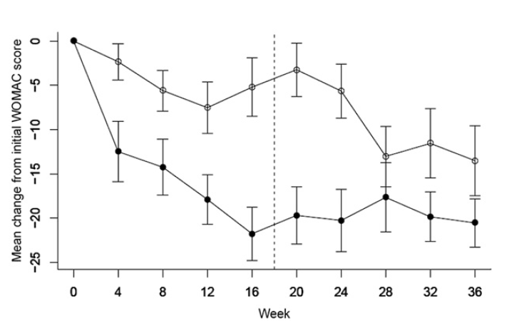
Dumais 2012

Slide 32
Topol OS Disease 2011
3 monthly dextrose injections vs regular treatment vs lidocaine
N=54
RCT blinded crossover
Level 1 evidence

Slide 33
Topol OS Disease 2011

Slide 34
Topol OS Disease 2011

Slide 35
Rabago,Patterson 2013
Rabago, Patterson, Annals of Family Medicine May/June 2013
4 Dextrose IA and EA injections vs saline vs exercise; RCT blinded
15 vs 8 vs 8 point improvement in WOMAC score for pain; 16 vs 5 vs 7 for function
52 week f/u
Level 1 evidence

Slide 36
Prolotherapy Research ,cont
5 Level 1 evidence Prolotherapy studies
10 Level 2 evidence Prolotherapy studies as well
Prolotherapy is taught in many residency training programs in many diciplines
Many questions remain but Prolotherapy is no longer experimental
Meets the U.S. Preventative Services Taskforce Recommendations for When Doctors Should Discuss a Treatment (Level 1 or 2 evidence with minimal risk)

Slide 37
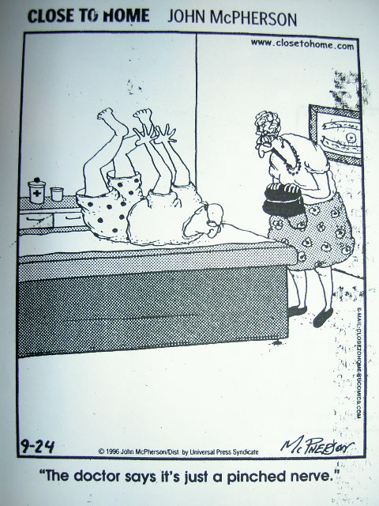

Slide 38
INDICATIONS AND PATIENT SELECTION
Ligamentous insufficiency or laxity
Chronic sprain/strain/ unresolved MFS
Diagnosis of exclusion
Clinical characteristics
Clinically unstable joint (facet/SI) with temporary relief from physical therapy or chiropractic
Often hypermobile individual
Pain is worse with prolonged sitting or standing
Localized reproducible pain

Slide 39
PATIENT SELECTION, Continued
Clinical characteristics, continued
Positive diagnostic blocks (beware of false negatives)
Range of motion often, but not always, reduced due to spasm (improves with treatment)
No neuro signs

Slide 40
The 5 Origins of Pain
There are only 5 things that can hurt:
Muscles
Ligaments
Joints
Nerves
Discs

Slide 41
INDICATIONS: RETHINKING LIGAMENTS
Limited understanding
Pain and functional loss related to ligament and tendon injury
Well recognized in extremities
Largely ignored in axial skeleton

Slide 42
INDICATIONS: PARADIGM SHIFT
Old Paradigm
Myofascial pain syndrome (Travell, 1960’s)
Tight muscles
Trigger points
Referred pain

Slide 43
INDICATIONS: PARADIGM SHIFT, Continued
New Paradigm I
Ligamentous laxity joint instability
Joint instability capsular pain
Long-term joint instability degenerative changes in joints
Degenerative changes pain

Slide 44
INDICATIONS: PARADIGM SHIFT, Continued
New Paradigm II
Ligamentous laxity joint instability
Joint instability muscle spasm
Chronic muscle spasm myofascial trigger points pain

Slide 45
INDICATIONS: PARADIGM SHIFT, Continued
New Paradigm III
Pain from ligaments
Pain from joints and joint capsules
Pain from muscles but secondary to ligamentous laxity
Pain from capsules not joints

Slide 46
TREATMENT BY PROLOTHERAPY
Guidelines
Not for acute cases
More conventional forms of treatment first
Diagnosis of exclusion
Treatment of total area of involvement (e.g., facets, SI joint)
Treat in four to six session blocks
Repeat sessions every two to six weeks

Slide 47
TREATMENT BY PROLOTHERAPY, Continued
Guidelines, continued
Reevaluate two months after four to six sessions are complete
Repeat series if greater than 30% but less than 90% improved in pain and/or function
Become technically proficient – no substitutes for proper training
Know your anatomy!
Informed consent
Routine sterile prep
Discontinue NSAIDS

Slide 48
INJECTION TECHNIQUE
Advance needle to touch bone at ligament attachment sites – both ends
Golden Rule: Needle always touches bone except intraarticular
Peppering Technique: 0.5 to 1.0cc at each site
Sterile prep

Slide 49
INJECTION TECHNIQUE, Continued
Basic Proliferant:
4cc Dextrose 50%
6cc Procaine 1%
Stronger solutions not advisable unless experienced

Slide 50
INJECTION TECHNIQUE, Continued
Results of Treatment
Often curative
Significant improvements in function and pain
Same outcome endpoints as PRP

Slide 51
PROLOTHERAPY
You should know this
No report of serious complications using Dextrose-based solutions and these techniques

