Slide 1
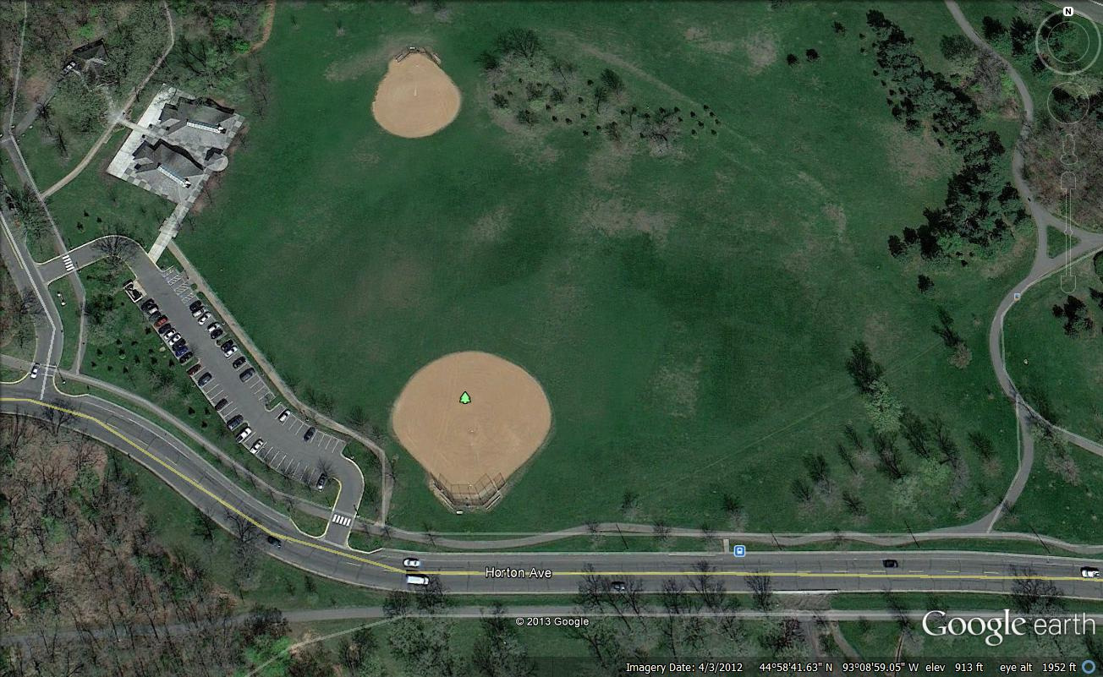
AC
Lunch, Medical, Vol. Ck In
D
Finish
A
ST
Start
Reg
Corrals
Vol. Park and Shuttle Bus Drop
17thMai
5 Tents – U Shape
P
P
P
P
P
Notes:
P=Port-A-Potty , Reg= Registration Tent, ST= School Tent, D= Radio Disney, AC= Adventures in Cardboard

