Slide 2
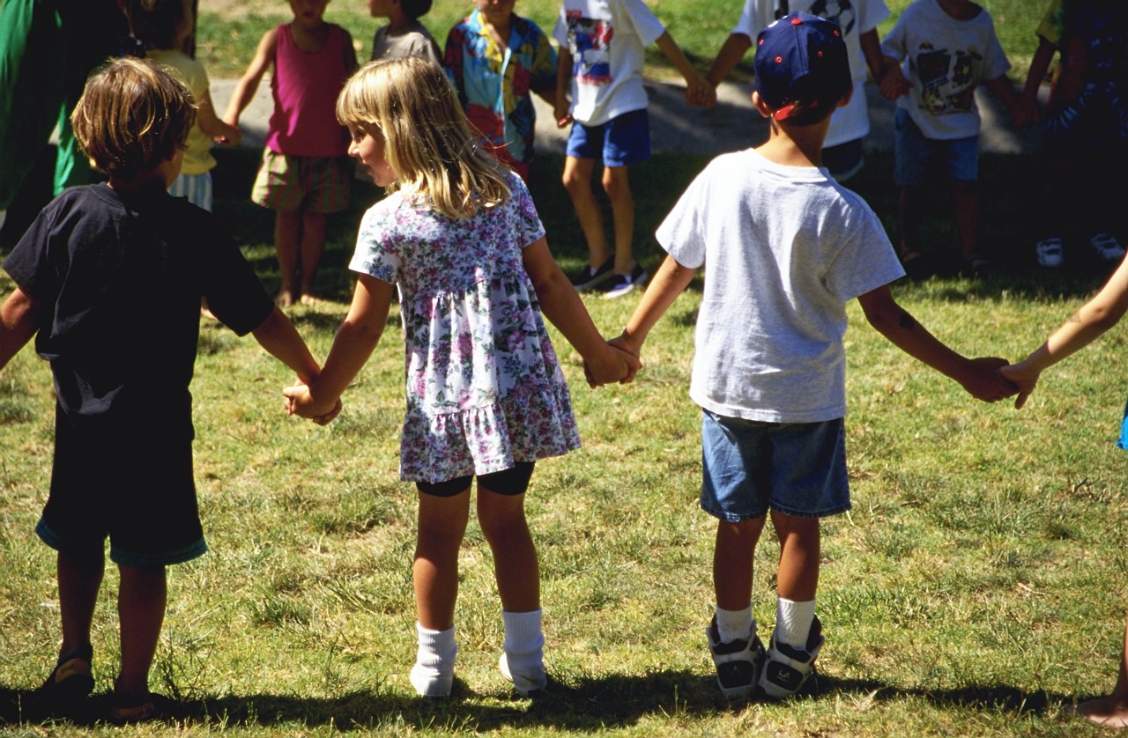
No matter what the issue, voters are most motivated by helping children.

Slide 3
Whether the issue is public health, as with a tobacco tax…
“Because studies show that ninety percent of smokers start as teens, focusing on youth is the best way to reduce smoking in California. The proven tobacco control programs funded by a tobacco tax will save tens of thousands of lives and tens of millions of dollars for taxpayers by keeping kids from starting smoking in the first place.”
64%
Convincing
Keeping children from starting to smoke is the #1 reason to support a tobacco tax
2013 Statewide Poll in California

Slide 4
…measuring national voter concern about a range of environmental issues…
Issues Ranked By Extremely/Very Serious | % Extremely/ Very Serious | % Total Serious
Kids not spending enough time outdoors and in nature | 50% | 82%
Pollution of rivers, lakes and streams | 42% | 76%
Pollution of oceans | 40% | 66%
Loss of property rights | 39% | 65%
After-effects of the oil spill in the Gulf of Mexico on wildlife and natural areas | 39% | 62%
Global warming | 36% | 60%
More frequent droughts | 35% | 62%
Not enough planning by local governments trying to direct how and where growth occurs in their communities | 34% | 67%
Loss of habitat for fish and wildlife | 34% | 63%
2012 National Poll for the Nature Conservancy

Slide 5
…winning support for a park bond in Houston…
“In today’s digital age it is more important than ever to preserve places where children can safely run, play and experience nature. Proposition B will expand Houston’s system of parks, trails and natural areas, giving more kids access to outdoor activities that will improve their overall physical health and well-being.”
79% Convincing

Slide 6
…building a new courthouse in a Midwestern county…
I am going to read you a list of some of the responsibilities of our local court system. Please tell me how important a priority you think each one should be for our courts -- is it an extremely important priority, very important, somewhat important, or not too important?
Total Ext./ Very Imp.
94%
93%
89%
86%
75%
45%
2013 Countywide Voter Survey

Slide 7
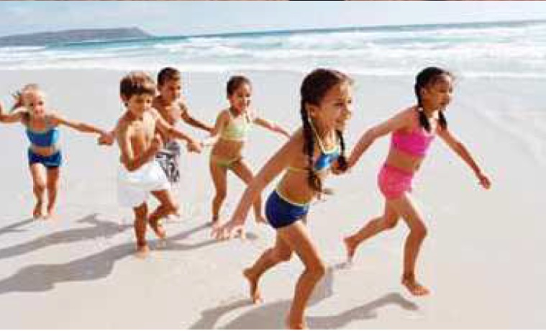
…or persuading voters to support regional ocean planning…
The image most commonly-chosen by focus group participants to attract their attention to ocean issues (shown above) was one of children playing in the surf on the beach.
It had more appeal than images of unique fish, seascapes, whales, undersea landscapes, wind turbines, seafood, or adults fishing.
2013 Focus Groups with Voters in Mid-Atlantic States

Slide 8
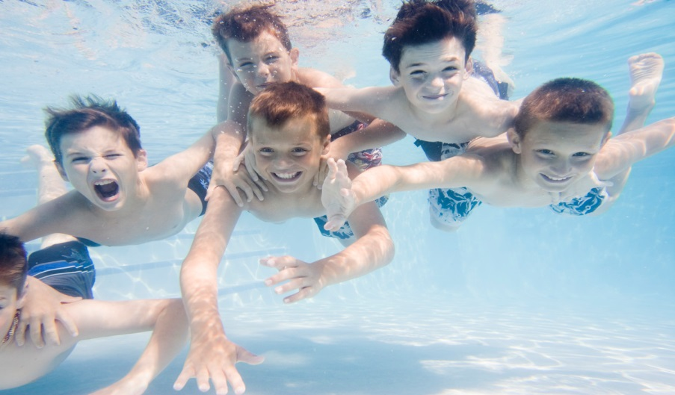
…time and time again, the path to success is showing how the measure will benefit children.
What is it that makes the public so prone to invest in services that will benefit children? Here are six key factors.

Slide 9
Voters rank helping kids as a more urgent priority than many other national issues.
#1:

Slide 10
Voters place children getting a strong start in life as one of the highest national priorities.
Now I'm going to read you some goals that people might have for our country right now, and I'd like you to rate how important you personally consider each goal to be ‐ is it extremely important, very important, somewhat important or not that important to you.
Ranked By % Extremely/Very Important
Extremely
Important
Making sure that our children get a strong start in life so they will perform better in school and succeed in their careers
Making sure that working parents can find quality, affordable child care for their young children
Improving access to quality health care for low‐income families
Improving roads, highways, and other infrastructure
2013 National Survey by Public Opinion Strategies/Hart Research Associates

Slide 11
Voters appreciate the critical and lasting importance of helping kids while they are very young.
#2:

Slide 12
A plurality of voters views one to three as the most critical ages in a child’s development.
What do you think is the most important age for developing a child’s capacity to learn? Is it…
2004 Arizona Voter Survey

Slide 13
Voters see addressing root problems early as the best way to keep kids out of trouble.
I am going to read you two statements that describe different approaches to addressing youth related problems. Please tell me which one you think is the best way to prevent kids from falling behind and dropping out of school or turning to gang violence and drug abuse.
Addressing root problems before they start by providing support services for kids and their families, like after-school and community based programs that keep kids out of trouble, encourage parent involvement, and teach non-violent conflict resolution.
Setting up stronger consequences for criminal and unacceptable behavior, which means putting more cops on the street, getting tough on juvenile crime and truancy, and ending social promotion.
Both/Neither/DK/NA
OR
2008 City of Oakland Survey

Slide 14
Voters don’t believe that we, as a society, are doing enough to help kids.
#3:

Slide 15
Overwhelmingly, voters say we should be doing more to ensure children start kindergarten ready to do their best – virtually no one says do less.
And when it comes to ensuring that children begin kindergarten with the knowledge and skills they need to do their best in school, do you think we should be doing more, doing less, or are doing enough?
2013 National Survey by Public Opinion Strategies/Hart Research Associates

Slide 16
And voters think that most kids are not prepared enough for learning when they enter kindergarten.
In general, how prepared do you think Arizona’s children are for learning when they enter kindergarten: are they…
Total Prepared
5%
Total Not Prepared
30%
2004 Arizona Statewide Survey

Slide 17
In our hyper-partisan time, kids are one issue that is non-partisan.
#4:

Slide 18
Voters across the political spectrum say that we should be doing more.
Start Kindergarten with Skills/Knowledge To Succeed By Party
2013 National Survey by Public Opinion Strategies/Hart Research Associates

Slide 19
Voters see investments in kids as helping everyone – not just individual kids and their families.
#5:

Slide 20
And three in five voters say these programs benefit everyone, not just the children who are enrolled and their families.
Pre-school programs benefit everyone, by leading to better-educated kids, lower crime rates, and a stronger economy.
Pre-school programs primarily benefit the children who are enrolled in them, and their parents and families.
Both/Neither/Not sure/Don't know
OR
2012 San Antonio Voter Survey

Slide 21
Voters recognize that the realities of modern life create a shared responsibility to children.
#6:

Slide 22
Voters recognize that often two parents have to work, and that we all have a responsibility to help children.
2004 Arizona Voter Survey

Slide 23

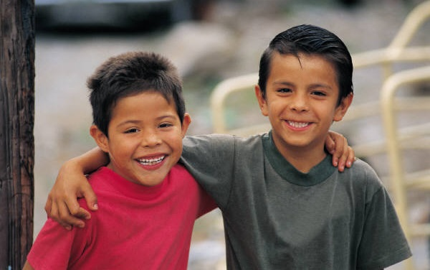
This all adds up to opportunity.

